Slide 1
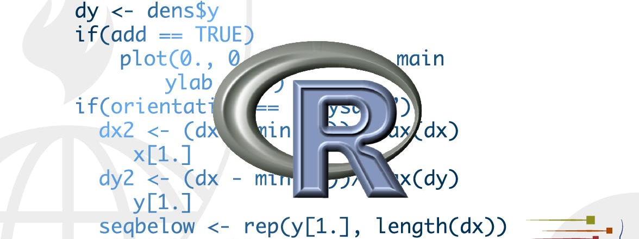
vectors
STA 4233 Introduction to Programming and Data Management in R
Notes:
So far this book has focussed on tibbles and packages that work with them. But as you start to write your own functions, and dig deeper into R, you need to learn about vectors, the objects that underlie tibbles. If you’ve learned R in a more traditional way, you’re probably already familiar with vectors, as most R resources start with vectors and work their way up to tibbles. I think it’s better to start with tibbles because they’re immediately useful, and then work your way down to the underlying components.
Vectors are particularly important as most of the functions you will write will work with vectors.

Slide 2
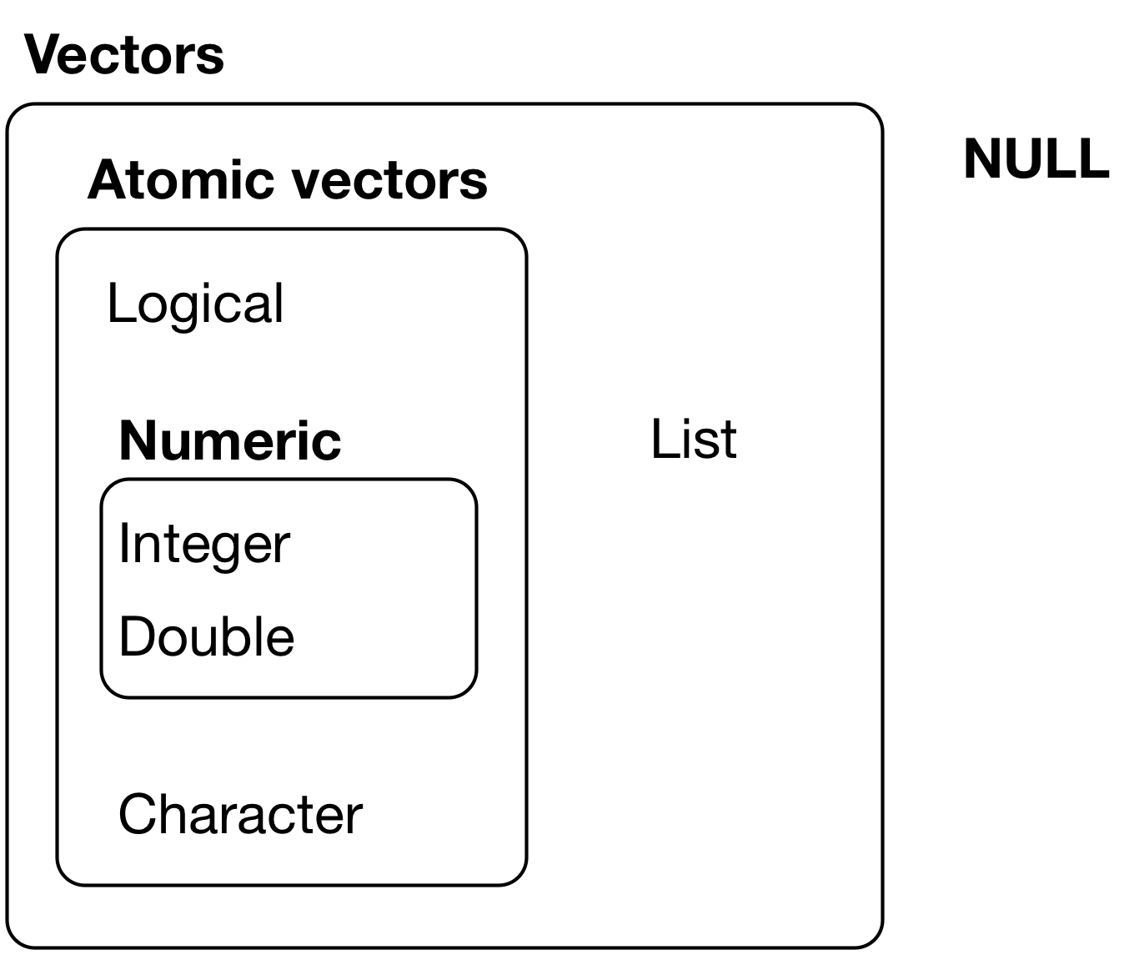
Vector basics
There are two types of vectors:
Atomic
logical
integer
double
character
complex
raw
Lists
numeric
homogeneous
heterogeneous
Notes:
There are two types of vectors:
Atomic vectors, of which there are six types: logical, integer, double, character, complex, and raw. Integer and double vectors are collectively known as numeric vectors.
Lists, which are sometimes called recursive vectors because lists can contain other lists.
The chief difference between atomic vectors and lists is that atomic vectors are homogeneous, while lists can be heterogeneous. There’s one other related object: NULL. NULL is often used to represent the absence of a vector (as opposed to NA which is used to represent the absence of a value in a vector). NULL typically behaves like a vector of length 0.

Slide 3
Properties of vectors
Every vector has two key properties:
type
length
typeof(letters)
#> [1] "character"
typeof(1:10)
#> [1] "integer"
x <- list("a", "b", 1:10)
length(x)
#> [1] 3
Notes:
Every vector has two key properties:
Its type, which you can determine with typeof().
typeof(letters) #> [1] "character" typeof(1:10) #> [1] "integer"
Its length, which you can determine with length().
x <- list("a", "b", 1:10) length(x) #> [1] 3

Slide 4
Augmented vectors
Factors are built on top of integer vectors.
Dates and date-times are built on top of numeric vectors.
Data frames and tibbles are built on top of lists.
Notes:
Vectors can also contain arbitrary additional metadata in the form of attributes. These attributes are used to create augmented vectors which build on additional behaviour. There are three important types of augmented vector:
Factors are built on top of integer vectors.
Dates and date-times are built on top of numeric vectors.
Data frames and tibbles are built on top of lists.
This lecture will introduce you to these important vectors from simplest to most complicated. You’ll start with atomic vectors, then build up to lists, and finish off with augmented vectors.

Slide 5
Important types of atomic vector
The four most important types of atomic vector are
logical
integer
double
character
Notes:
The four most important types of atomic vector are logical, integer, double, and character. Raw and complex are rarely used during a data analysis, so I won’t discuss them here.

Slide 6
Logical
1:10 %% 3 == 0
#> [1] FALSE FALSE TRUE FALSE FALSE TRUE FALSE FALSE TRUE FALSE
c(TRUE, TRUE, FALSE, NA)
#> [1] TRUE TRUE FALSE NA
Notes:
Logical vectors are the simplest type of atomic vector because they can take only three possible values: FALSE, TRUE, and NA. Logical vectors are usually constructed with comparison operators, as described in comparisons. You can also create them by hand with c():

Slide 7
Numeric
typeof(1)
#> [1] "double"
typeof(1L)
#> [1] "integer"
1.5L
#> [1] 1.5
Notes:
Integer and double vectors are known collectively as numeric vectors. In R, numbers are doubles by default. To make an integer, place an L after the number:

Slide 8
Integers v doubles
Doubles are approximations
Integers have one special value, doubles have four
x <- sqrt(2) ^ 2
x
#> [1] 2
x - 2
#> [1] 4.44e-16
c(-1, 0, 1) / 0
#> [1] -Inf NaN Inf
Notes:
The distinction between integers and doubles is not usually important, but there are two important differences that you should be aware of:
Doubles are approximations. Doubles represent floating point numbers that can not always be precisely represented with a fixed amount of memory. This means that you should consider all doubles to be approximations. For example, what is square of the square root of two?
x <- sqrt(2) ^ 2 x #> [1] 2 x - 2 #> [1] 4.44e-16
This behaviour is common when working with floating point numbers: most calculations include some
approximation error. Instead of comparing floating point numbers using ==, you should
use dplyr::near() which allows for some numerical tolerance.
Integers have one special value: NA, while doubles have four: NA, NaN, Inf and -Inf. All three special values NaN, Inf and -Inf can arise during division:
c(-1, 0, 1) / 0 #> [1] -Inf NaN Inf

Slide 9
Checking for special values
 | 0 | Inf | NA | NaN
is.finit() | X
is.infinite() |  | X
is.na() |  |  | X | X
is.nan() |  |  |  | X
Notes:
Avoid using == to check for these other special values. Instead use the helper functions is.finite(), is.infinite(), and is.nan():

Slide 10
Character
x <- "This is a reasonably long string."
pryr::object_size(x)
#> Registered S3 method overwritten by 'pryr’:
#> method from
#> print.bytes Rcpp
#> 152 B
y <- rep(x, 1000)
pryr::object_size(y)
#> 8.14 kB
Notes:
Character vectors are the most complex type of atomic vector, because each element of a character vector is a string, and a string can contain an arbitrary amount of data.
You’ve already learned a lot about working with strings in strings. Here I wanted to mention one important feature of the underlying string implementation: R uses a global string pool. This means that each unique string is only stored in memory once, and every use of the string points to that representation. This reduces the amount of memory needed by duplicated strings. You can see this behaviour in practice with pryr::object_size():
y doesn’t take up 1,000x as much memory as x, because each element of y is just a pointer to that same string. A pointer is 8 bytes, so 1000 pointers to a 136 B string is 8 * 1000 + 136 = 8.13 kB.

Slide 11
Missing values
NA # logical
#> [1] NA
NA_integer_ # integer
#> [1] NA
NA_real_ # double
#> [1] NA
NA_character_ # character
#> [1] NA
Notes:
Note that each type of atomic vector has its own missing value:
Normally you don’t need to know about these different types because you can always use NA and it will be converted to the correct type using the implicit coercion rules described next. However, there are some functions that are strict about their inputs, so it’s useful to have this knowledge sitting in your back pocket so you can be specific when needed.

Slide 12
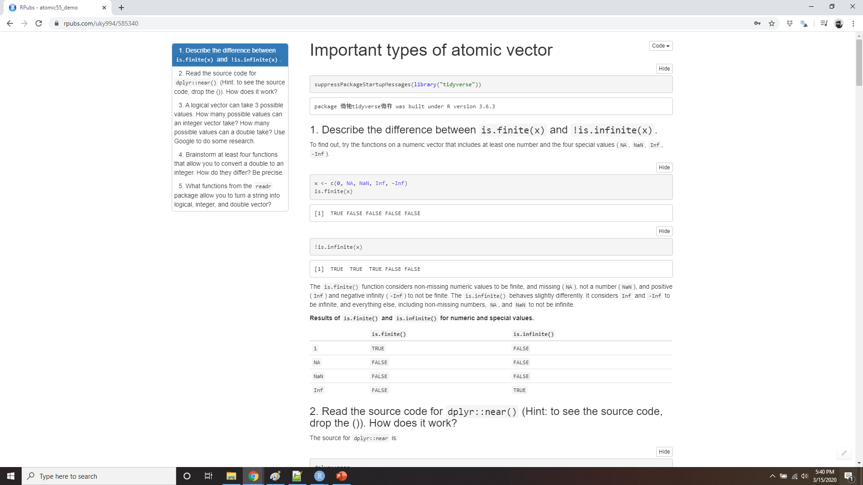
Demo Important types of atomic vector
Notes:
https://rpubs.com/uky994/585340
Describe the difference between is.finite(x) and !is.infinite(x).
Read the source code for dplyr::near() (Hint: to see the source code, drop the ()). How does it work?
A logical vector can take 3 possible values. How many possible values can an integer vector take? How many possible values can a double take? Use google to do some research.
Brainstorm at least four functions that allow you to convert a double to an integer. How do they differ? Be precise.
What functions from the readr package allow you to turn a string into logical, integer, and double vector?

Slide 13
Using atomic vectors
How to convert from one type to another, and when that happens automatically.
How to tell if an object is a specific type of vector.
What happens when you work with vectors of different lengths.
How to name the elements of a vector.
How to pull out elements of interest.
Notes:
Now that you understand the different types of atomic vector, it’s useful to review some of the important tools for working with them. These include:
How to convert from one type to another, and when that happens automatically.
How to tell if an object is a specific type of vector.
What happens when you work with vectors of different lengths.
How to name the elements of a vector.
How to pull out elements of interest.

Slide 14

Coercion
Explicit coercion happens when you call a function like as.*()
Implicit coercion happens when you use a vector in a specific context that expects a certain type of vector
Notes:
There are two ways to convert, or coerce, one type of vector to another:
Explicit coercion happens when you call a function like as.logical(), as.integer(), as.double(), or as.character(). Whenever you find yourself using explicit coercion, you should always check whether you can make the fix upstream, so that the vector never had the wrong type in the first place. For example, you may need to tweak your readr col_types specification.
Implicit coercion happens when you use a vector in a specific context that expects a certain type of vector. For example, when you use a logical vector with a numeric summary function, or when you use a double vector where an integer vector is expected.
Because explicit coercion is used relatively rarely, and is largely easy to understand, I’ll focus on implicit coercion here.

Slide 15
implicit coercion
x <- sample(20, 100, replace = TRUE)
y <- x > 10
sum(y) # how many are greater than 10?
#> [1] 38
mean(y) # what proportion are greater than 10?
#> [1] 0.38
Notes:
You’ve already seen the most important type of implicit coercion: using a logical vector in a numeric context. In this case TRUE is converted to 1 and FALSE converted to 0. That means the sum of a logical vector is the number of trues, and the mean of a logical vector is the proportion of trues:

Slide 16
implicit coercion
if (length(x)) {
# do something
}
if (length(x) > 0) {
# do something
}
Notes:
You may see some code (typically older) that relies on implicit coercion in the opposite direction, from integer to logical:
In this case, 0 is converted to FALSE and everything else is converted to TRUE. I think this makes it harder to understand your code, and I don’t recommend it. Instead be explicit: length(x) > 0.

Slide 17
implicit coercion
typeof(c(TRUE, 1L))
#> [1] "integer"
typeof(c(1L, 1.5))
#> [1] "double"
typeof(c(1.5, "a"))
#> [1] "character"
Notes:
It’s also important to understand what happens when you try and create a vector containing multiple types with c(): the most complex type always wins.
An atomic vector can not have a mix of different types because the type is a property of the complete vector, not the individual elements. If you need to mix multiple types in the same vector, you should use a list, which you’ll learn about shortly.

Slide 18
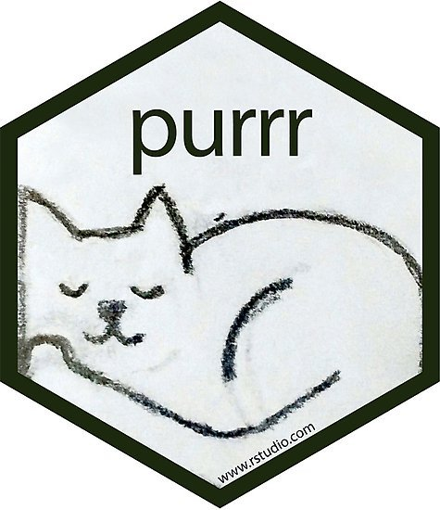
Test functions
 | lgl | int | dbl | chr | List
is_logical() | X
is_integer() |  | X
is_double() |  |  | X
is_numeric() |  | X | X
is_character() |  |  |  | X
is_atomic | X | X | X | X
is_list() |  |  |  |  | X
is_vector() | X | X | X | X | X
Notes:
Sometimes you want to do different things based on the type of vector. One option is to use typeof(). Another is to use a test function which returns a TRUE or FALSE. Base R provides many functions like is.vector() and is.atomic(), but they often return surprising results. Instead, it’s safer to use the is_* functions provided by purrr, which are summarized in the table.
Each predicate also comes with a “scalar” version, like is_scalar_atomic(), which checks that the length is 1. This is useful, for example, if you want to check that an argument to your function is a single logical value.

Slide 19
Scalars and recycling rules
sample(10) + 100
#> [1] 107 104 103 109 102 101 106 110 105 108
runif(10) > 0.5
#> [1] FALSE TRUE FALSE FALSE TRUE TRUE TRUE TRUE TRUE TRUE
Notes:
As well as implicitly coercing the types of vectors to be compatible, R will also implicitly coerce the length of vectors. This is called vector recycling, because the shorter vector is repeated, or recycled, to the same length as the longer vector.
This is generally most useful when you are mixing vectors and “scalars”. I put scalars in quotes because R doesn’t actually have scalars: instead, a single number is a vector of length 1. Because there are no scalars, most built-in functions are vectorised, meaning that they will operate on a vector of numbers. That’s why, for example, this code works:
In R, basic mathematical operations work with vectors. That means that you should never need to perform explicit iteration when performing simple mathematical computations.

Slide 20
adding vectors with different lengths
1:10 + 1:2
#> [1] 2 4 4 6 6 8 8 10 10 12
Notes:
It’s intuitive what should happen if you add two vectors of the same length, or a vector and a “scalar”, but what happens if you add two vectors of different lengths?
Here, R will expand the shortest vector to the same length as the longest, so called recycling.

Slide 21
No warning?
1:10 + 1:3
#> Warning in 1:10 + 1:3: longer object length is not a multiple
#> of shorter object #> length #> [1] 2 4 6 5 7 9 8 10 12 11
Notes:
This is silent except when the length of the longer is not an integer multiple of the length of the shorter:

Slide 22
No warning?
tibble(x = 1:4, y = 1:2)
#> Error: Tibble columns must have
#> consistent lengths, only values of
#> length one are recycled:
#> * Length 2: Column `y`
#> * Length 4: Column `x`
tibble(x = 1:4, y = rep(1:2, 2))
#> # A tibble: 4 x 2
#> x y
#> <int> <int>
#> 1 1 1
#> 2 2 2
#> 3 3 1
#> 4 4 2
tibble(x = 1:4, y = rep(1:2, each = 2))
#> # A tibble: 4 x 2
#> x y
#> <int> <int>
#> 1 1 1
#> 2 2 1
#> 3 3 2
#> 4 4 2
Notes:
While vector recycling can be used to create very succinct, clever code, it can also silently conceal problems. For this reason, the vectorised functions in tidyverse will throw errors when you recycle anything other than a scalar. If you do want to recycle, you’ll need to do it yourself with rep():

Slide 23
Naming vectors
c(x = 1, y = 2, z = 4)
#> x y z
#> 1 2 4
purr::set_names(1:3, c("a", "b", "c"))
#> a b c
#> 1 2 3
Notes:
All types of vectors can be named. You can name them during creation with c():
Or after the fact with purrr::set_names():
Named vectors are most useful for subsetting, described next.

Slide 24
Subsetting
There are four types of things that you can subset a vector with:
A numeric vector containing only integers
Subsetting with a logical vector keeps all values corresponding to a TRUE value
If you have a named vector, you can subset it with a character vector
The simplest type of subsetting is nothing, x[], which returns the complete x.
Notes:
So far we’ve used dplyr::filter() to filter the rows in a tibble. filter() only works with tibble, so we’ll need new tool for vectors: [. [ is the subsetting function, and is called like x[a]. There are four types of things that you can subset a vector with:
A numeric vector containing only integers
Subsetting with a logical vector keeps all values corresponding to a TRUE value
If you have a named vector, you can subset it with a character vector
The simplest type of subsetting is nothing, x[], which returns the complete x.

Slide 25
Subsetting with a numeric vector
x <- c("one", "two", "three", "four", "five")
x[c(3, 2, 5)]
#> [1] "three" "two" "five"
x[c(1, 1, 5, 5, 5, 2)]
#> [1] "one" "one" "five" "five" "five" "two"
x[c(-1, -3, -5)]
#> [1] "two" "four"
x[c(1, -1)]
#> Error in x[c(1, -1)]: only 0's may be mixed with
#> negative subscripts
x[0] #> character(0)
Notes:
you can subset a vector with a numeric vector containing only integers. The integers must either be all positive, all negative, or zero.
Subsetting with positive integers keeps the elements at those positions:
By repeating a position, you can actually make a longer output than input:
Negative values drop the elements at the specified positions
It’s an error to mix positive and negative values:
The error message mentions subsetting with zero, which returns no values:
This is not useful very often, but it can be helpful if you want to create unusual data structures to test your functions with.

Slide 26
Subsetting with a logical vector
x <- c(10, 3, NA, 5, 8, 1, NA)
# All non-missing values of x
x[!is.na(x)]
#> [1] 10 3 5 8 1
# All even (or missing!) values of x
x[x %% 2 == 0]
#> [1] 10 NA 8 NA
Notes:
2. you can subset with a logical vector keeps all values corresponding to a TRUE value. This is most often useful
in conjunction with the comparison functions.

Slide 27
Subsetting with a named vector
x <- c(abc = 1, def = 2, xyz = 5)
x[c("xyz", "def")]
#> xyz def #> 5 2
Notes:
If you have a named vector, you can subset it with a character vector:
Like with positive integers, you can also use a character vector to duplicate individual entries.

Slide 28
X[ ]
returns the complete x
useful when subsetting high dimensional structures
> x<-iris[1:2,1:2]
> x[1,]
Sepal.Length Sepal.Width
1 5.1 3.5
> x[,-1]
[1] 3.5 3.0
Read the “Subsetting” chapter of Advanced R:
http://adv-r.had.co.nz/Subsetting.html#applications.
Notes:
The simplest type of subsetting is nothing, x[], which returns the complete x. This is not useful for subsetting vectors, but it is useful when subsetting matrices (and other high dimensional structures) because it lets you select all the rows or all the columns, by leaving that index blank. For example, if x is 2d, x[1, ] selects the first row and all the columns, and x[, -1] selects all rows and all columns except the first.
To learn more about the applications of subsetting, reading the “Subsetting” chapter of Advanced R: http://adv-r.had.co.nz/Subsetting.html#applications.
There is an important variation of [ called [[. [[ only ever extracts a single element, and always drops names. It’s a good idea to use it whenever you want to make it clear that you’re extracting a single item, as in a for loop. The distinction between [ and [[ is most important for lists, as we’ll see shortly.

Slide 29
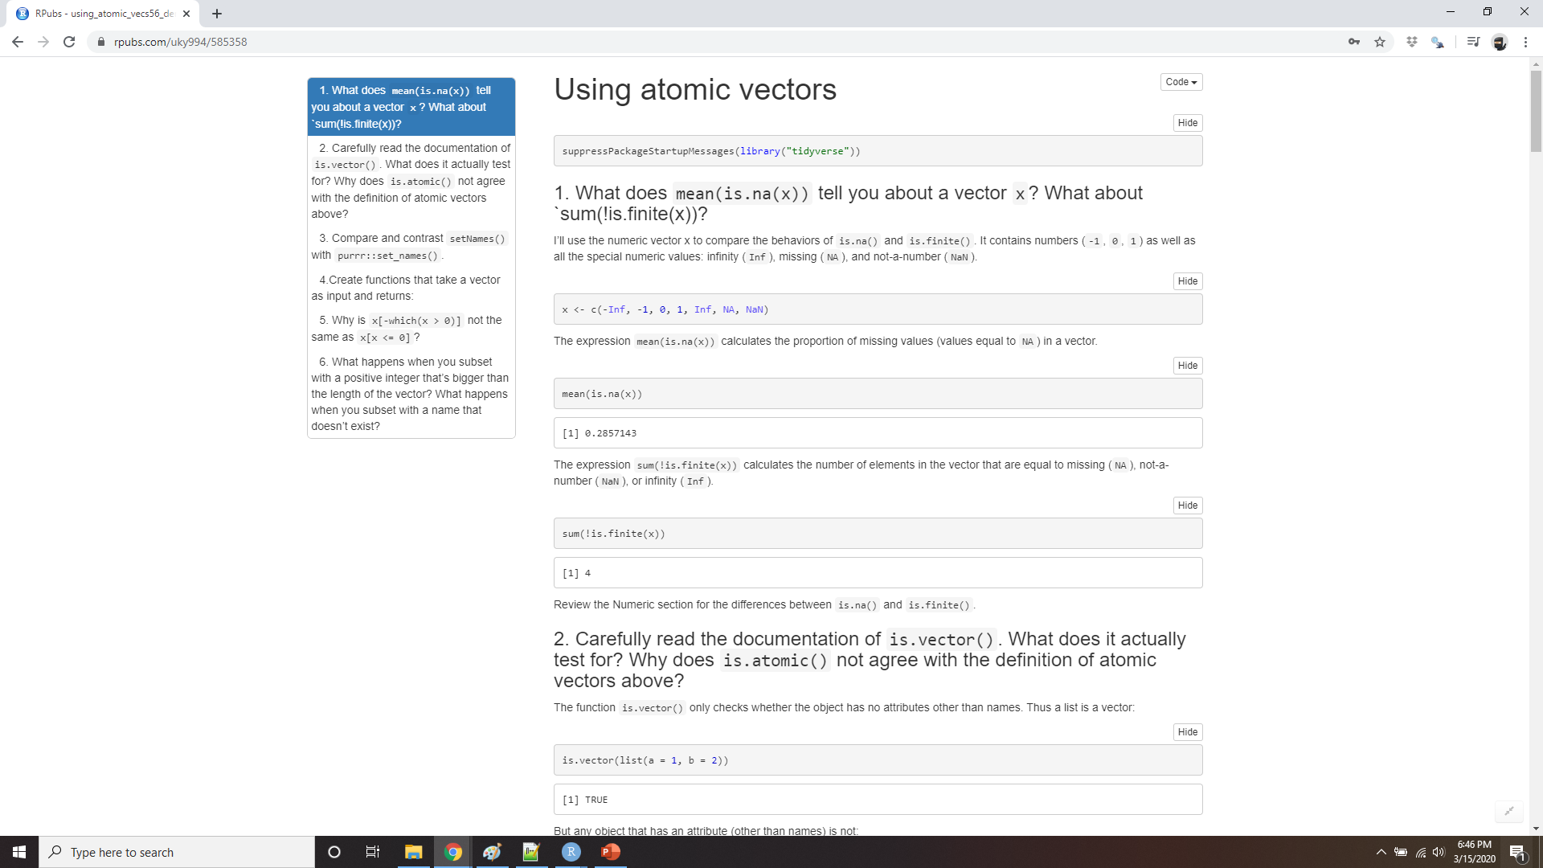
Demo using atomic vectors
Notes:
https://rpubs.com/uky994/585358
What does mean(is.na(x)) tell you about a vector x? What about sum(!is.finite(x))?
Carefully read the documentation of is.vector(). What does it actually test for? Why does is.atomic() not agree with the definition of atomic vectors above?
Compare and contrast setNames() with purrr::set_names().
Create functions that take a vector as input and returns:
The last value. Should you use [ or [[?
The elements at even numbered positions.
Every element except the last value.
Only even numbers (and no missing values).
Why is x[-which(x > 0)] not the same as x[x <= 0]?
What happens when you subset with a positive integer that’s bigger than the length of the vector? What happens when you subset with a name that doesn’t exist?

Slide 30
Recursive vectors (lists)
x <- list(1, 2, 3)
x
#> [[1]]
#> [1] 1
#>
#> [[2]]
#> [1] 2
#>
#> [[3]]
#> [1] 3
Notes:
Lists are a step up in complexity from atomic vectors, because lists can contain other lists. This makes them suitable for representing hierarchical or tree-like structures. You create a list with list()

Slide 31
Str()
str(x)
#> List of 3
#> $ : num 1
#> $ : num 2
#> $ : num 3
x_named <- list(a = 1, b = 2, c = 3)
str(x_named)
#> List of 3
#> $ a: num 1
#> $ b: num 2
#> $ c: num 3
Notes:
A very useful tool for working with lists is str() because it focusses on the structure, not the contents.

Slide 32
List() can contain anything
y <- list("a", 1L, 1.5, TRUE)
str(y)
#> List of 4
#> $ : chr "a"
#> $ : int 1
#> $ : num 1.5
#> $ : logi TRUE
Notes:
Unlike atomic vectors, list() can contain a mix of objects:

Slide 33
even other lists!
z <- list(list(1, 2), list(3, 4))
str(z)
#> List of 2
#> $ :List of 2
#> ..$ : num 1
#> ..$ : num 2
#> $ :List of 2
#> ..$ : num 3
#> ..$ : num 4
Notes:
Lists can even contain other lists!

Slide 34
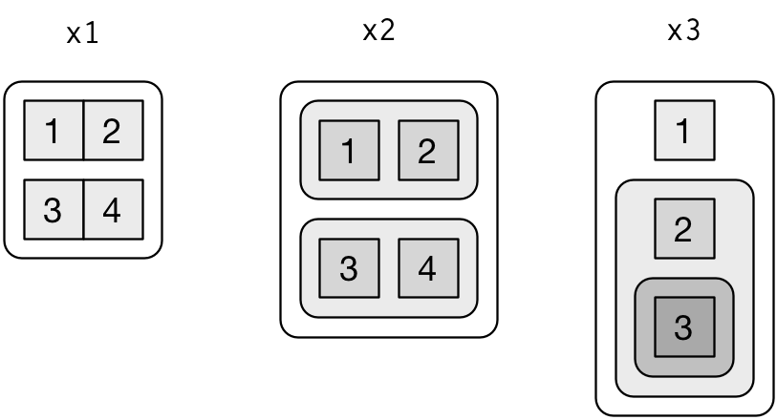
Visualising lists
x1 <- list(c(1, 2), c(3, 4))
x2 <- list(list(1, 2), list(3, 4))
x3 <- list(1, list(2, list(3)))
Notes:
To explain more complicated list manipulation functions, it’s helpful to have a visual representation of lists. For example, take these three lists:
There are three principles:
Lists have rounded corners. Atomic vectors have square corners.
Children are drawn inside their parent, and have a slightly darker background to make it easier to see the hierarchy.
The orientation of the children (i.e. rows or columns) isn’t important, so I’ll pick a row or column orientation to either save space or illustrate an important property in the example.

Slide 35
Subsetting lists with [
a <- list(a = 1:3, b = "a string", c = pi, d = list(-1, -5))
str(a[1:2])
#> List of 2
#> $ a: int [1:3] 1 2 3
#> $ b: chr "a string"
str(a[4])
#> List of 1
#> $ d:List of 2
#> ..$ : num -1
#> ..$ : num -5
Notes:
There are three ways to subset a list, which I’ll illustrate with a list named a:
[ extracts a sub-list. The result will always be a list.
Like with vectors, you can subset with a logical, integer, or character vector.

Slide 36
Subsetting lists with [[
str(a[[1]])
#> int [1:3] 1 2 3
str(a[[4]])
#> List of 2
#> $ : num -1
#> $ : num -5
Notes:
[[ extracts a single component from a list. It removes a level of hierarchy from the list.

Slide 37
Subsetting lists with $
a$a
#> [1] 1 2 3
a[["a"]]
#> [1] 1 2 3
Notes:
$ is a shorthand for extracting named elements of a list. It works similarly to [[ except that you don’t need to use quotes.

Slide 38
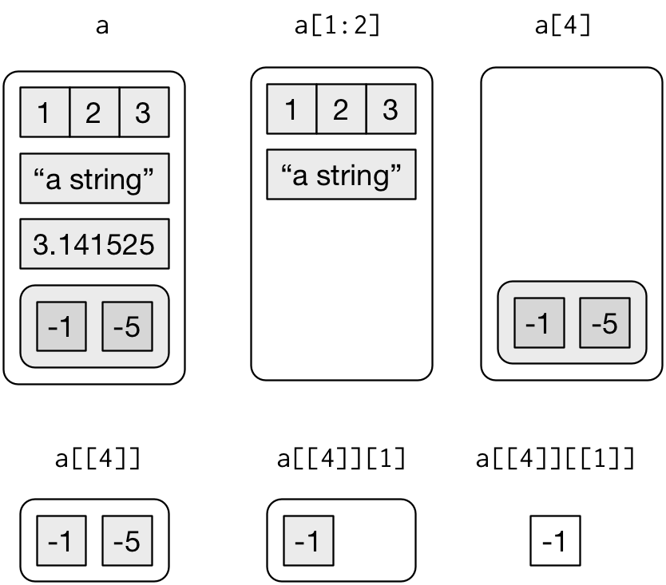
[ vs [[
Notes:
The distinction between [ and [[ is really important for lists, because [[ drills down into the list while [ returns a new, smaller list. Compare the code and output above with the visual representation in Figure.

Slide 39

[ vs [[
= x
Notes:
The difference between [ and [[ is very important, but it’s easy to get confused. To help you remember, let me show you an unusual pepper shaker.
If this pepper shaker is your list x, then,

Slide 40
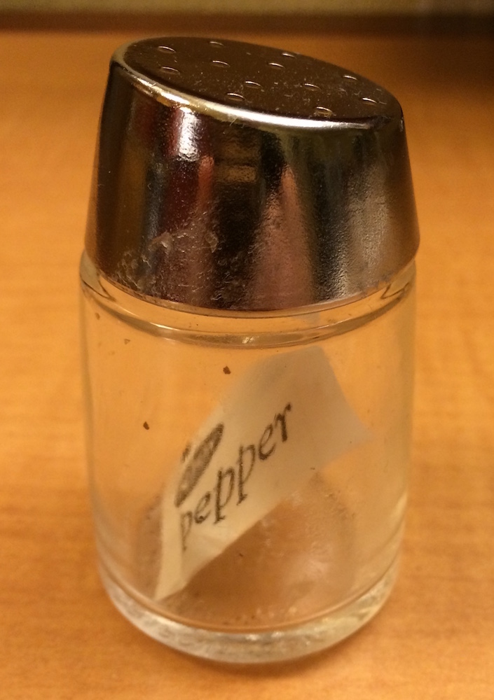
X[1]
Notes:
x[1] is a pepper shaker containing a single pepper packet:
x[2] would look the same, but would contain the second packet. x[1:2] would be a pepper shaker containing two pepper packets.

Slide 41
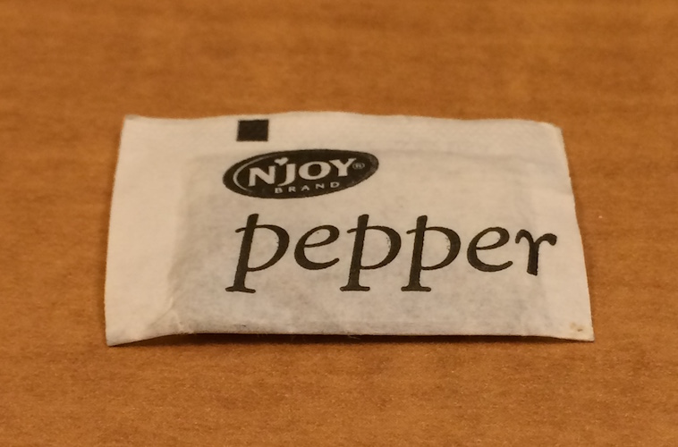
x[[1]]
Notes:
x[[1]] is:

Slide 42

x[[1]][[1]]
Notes:
If you wanted to get the content of the pepper package, you’d need x[[1]][[1]]

Slide 43
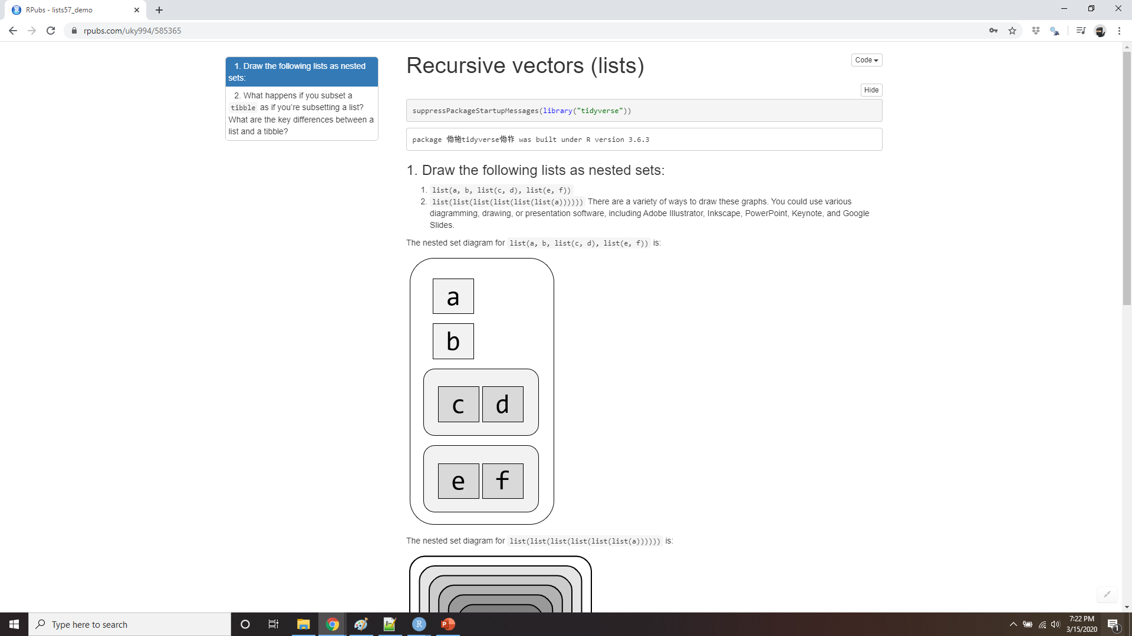
Demo recursive vectors (lists)
Notes:
https://rpubs.com/uky994/585365
Draw the following lists as nested sets:
list(a, b, list(c, d), list(e, f))
list(list(list(list(list(list(a))))))
What happens if you subset a tibble as if you’re subsetting a list? What are the key differences between a list and a tibble?

Slide 44
Attributes
x <- 1:10
attr(x, "greeting")
#> NULL
attr(x, "greeting") <- "Hi!"
attr(x, "farewell") <- "Bye!"
attributes(x)
#> $greeting
#> [1] "Hi!"
#>
#> $farewell
#> [1] "Bye!"
Notes:
Any vector can contain arbitrary additional metadata through its attributes. You can think of attributes as named list of vectors that can be attached to any object. You can get and set individual attribute values with attr() or see them all at once with attributes().

Slide 45
Attributes
Names name the elements of a vector.
Dimensions (dims, for short) make a vector behave like a matrix or array.
Class is used to implement the S3 object oriented system
http://adv-r.had.co.nz/OO-essentials.html#s3.
Notes:
There are three very important attributes that are used to implement fundamental parts of R:
Names are used to name the elements of a vector.
Dimensions (dims, for short) make a vector behave like a matrix or array.
Class is used to implement the S3 object oriented system.
You’ve seen names above, and we won’t cover dimensions because we don’t use matrices in this course. It remains to describe the class, which controls how generic functions work. Generic functions are key to object oriented programming in R, because they make functions behave differently for different classes of input. A detailed discussion of object oriented programming is beyond the scope of this book, but you can read more about it in Advanced R at http://adv-r.had.co.nz/OO-essentials.html#s3.

Slide 46
Attributes
as.Date
#> function (x, ...)
#> UseMethod("as.Date")
#> <bytecode: 0x42f6968>
#> <environment: namespace:base>
Notes:
Here’s what a typical generic function looks like:
The call to “UseMethod” means that this is a generic function, and it will call a specific method, a function, based on the class of the first argument.

Slide 47
Methods()
methods("as.Date")
#> [1] as.Date.character as.Date.default as.Date.factor
#> [4] as.Date.numeric as.Date.POSIXct as.Date.POSIXlt
#> [7] as.Date.vctrs_sclr* as.Date.vctrs_vctr*
#> see '?methods' for accessing help and source code
Notes:
(All methods are functions; not all functions are methods). You can list all the methods for a generic with methods():

Slide 48
getS3method("as.Date", "default")
#> function (x, ...) #> {
#> if (inherits(x, "Date"))
#> x
#> else if (is.logical(x) && all(is.na(x)))
#> .Date(as.numeric(x))
#> else stop(gettextf("do not know how to convert '%s' to class %s",
#> deparse(substitute(x)), dQuote("Date")), domain = NA)
#> }
#> <bytecode: 0x4f30d48>
#> <environment: namespace:base>
getS3method("as.Date", "numeric")
#> function (x, origin, ...)
#> {
#> if (missing(origin))
#> stop("'origin' must be supplied")
#> as.Date(origin, ...) + x
#> }
#> <bytecode: 0x84fa058>
#> <environment: namespace:base>
Notes:
For example, if x is a character vector, as.Date() will call as.Date.character(); if it’s a factor, it’ll call as.Date.factor().
You can see the specific implementation of a method with getS3method()
The most important S3 generic is print(): it controls how the object is printed when you type its name at the console. Other important generics are the subsetting functions [, [[, and $.

Slide 49
Augmented vectors
Factors
Dates
Date-times
Tibbles
Notes:
Atomic vectors and lists are the building blocks for other important vector types like factors and dates. I call these augmented vectors, because they are vectors with additional attributes, including class. Because augmented vectors have a class, they behave differently to the atomic vector on which they are built. In this course, we make use of four important augmented vectors:
Factors
Dates
Date-times
Tibbles
These are described below.

Slide 50
Factors
x <- factor(c("ab", "cd", "ab"), levels = c("ab", "cd", "ef")) typeof(x)
#> [1] "integer"
attributes(x)
#> $levels
#> [1] "ab" "cd" "ef"
#>
#> $class
#> [1] "factor"
Notes:
Factors are designed to represent categorical data that can take a fixed set of possible values. Factors are built on top of integers, and have a levels attribute

Slide 51
Dates and date-times
x <- as.Date("1971-01-01")
unclass(x)
#> [1] 365
typeof(x)
#> [1] "double"
attributes(x)
#> $class
#> [1] "Date"
Notes:
Dates in R are numeric vectors that represent the number of days since 1 January 1970

Slide 52
Dates and date-times
x <- lubridate::ymd_hm("1970-01-01 01:00")
unclass(x)
#> [1] 3600
#> attr(,"tzone")
#> [1] "UTC"
typeof(x)
#> [1] "double"
attributes(x)
#> $class
#> [1] "POSIXct" "POSIXt"
#>
#> $tzone
#> [1] "UTC"
Notes:
Date-times are numeric vectors with class POSIXct that represent the number of seconds since 1 January 1970. (In case you were wondering, “POSIXct” stands for “Portable Operating System Interface”, calendar time.)

Slide 53
Dates and date-times
attr(x, "tzone") <- "US/Pacific"
x
#> [1] "1969-12-31 17:00:00 PST"
attr(x, "tzone") <- "US/Eastern"
x
#> [1] "1969-12-31 20:00:00 EST"
Notes:
The tzone attribute is optional. It controls how the time is printed, not what absolute time it refers to.

Slide 54
Dates and date-times
y <- as.POSIXlt(x)
typeof(y)
#> [1] "list"
attributes(y)
#> $names
#> [1] "sec" "min" "hour" "mday" "mon" "year" "wday" "yday"
#> [9] "isdst" "zone" "gmtoff"
#>
#> $class
#> [1] "POSIXlt" "POSIXt"
#>
#> $tzone
#> [1] "US/Eastern" "EST" "EDT"
Notes:
There is another type of date-times called POSIXlt. These are built on top of named lists:
POSIXlts are rare inside the tidyverse. They do crop up in base R, because they are needed to extract specific components of a date, like the year or month. Since lubridate provides helpers for you to do this instead, you don’t need them. POSIXct’s are always easier to work with, so if you find you have a POSIXlt, you should always convert it to a regular data time lubridate::as_date_time().

Slide 55
Tibbles
tb <- tibble::tibble(x = 1:5, y = 5:1)
typeof(tb)
#> [1] "list"
attributes(tb)
#> $names
#> [1] "x" "y"
#>
#> $row.names
#> [1] 1 2 3 4 5
#>
#> $class
#> [1] "tbl_df" "tbl" "data.frame"
Notes:
Tibbles are augmented lists: they have class “tbl_df” + “tbl” + “data.frame”, and names (column) and row.names attributes:
The difference between a tibble and a list is that all the elements of a data frame must be vectors with the same length. All functions that work with tibbles enforce this constraint.

Slide 56
Data frames
df <- data.frame(x = 1:5, y = 5:1)
typeof(df)
#> [1] "list"
attributes(df)
#> $names
#> [1] "x" "y"
#>
#> $class
#> [1] "data.frame"
#>
#> $row.names
#> [1] 1 2 3 4 5
Notes:
Traditional data.frames have a very similar structure
The main difference is the class. The class of tibble includes “data.frame” which means tibbles inherit the regular data frame behaviour by default.

Slide 57
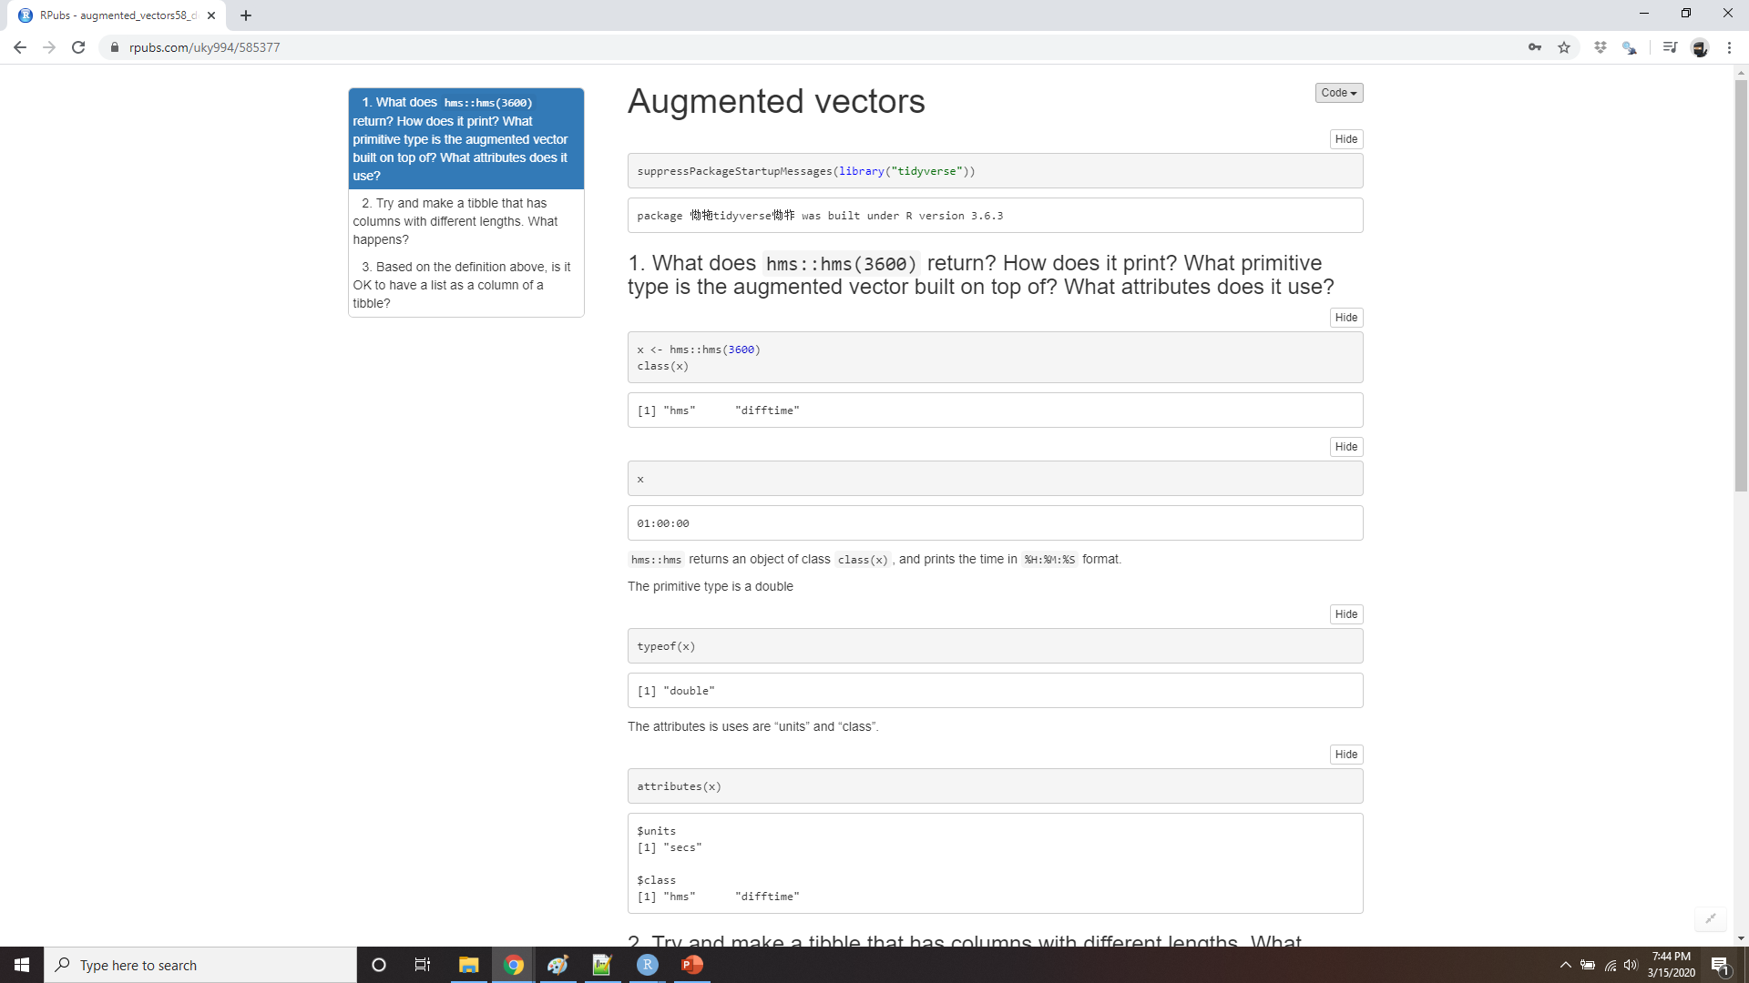
Demo augmented vectors
Notes:
https://rpubs.com/uky994/585377
What does hms::hms(3600) return? How does it print? What primitive type is the augmented vector built on top of? What attributes does it use?
Try and make a tibble that has columns with different lengths. What happens?
Based on the definition above, is it ok to have a list as a column of a tibble?

